Slide 1
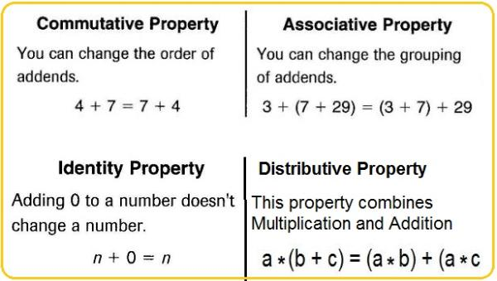

Slide 2
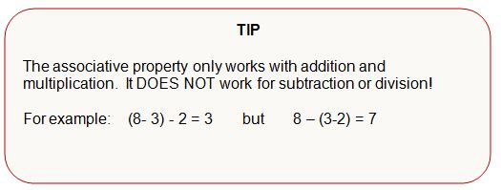

Slide 4
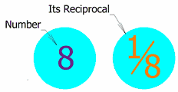
Multiplicative Inverse
Another name for Reciprocal. When you multiply a number by its "Multiplicative Inverse" you get 1. Example: 8 × (1/8) = 1

Slide 5
Whole Numbers
Whole Numbers
Whole Numbers are simply the numbers 0, 1, 2, 3, 4, 5, ... (and so on)
No Fractions!
Counting Numbers
Counting Numbers are Whole Numbers, but without the zero. Because you can't "count" zero.
So they are 1, 2, 3, 4, 5, ... (and so on).

Slide 6
Natural Numbers
"Natural Numbers" can mean either "Counting Numbers" {1, 2, 3, ...}, or "Whole Numbers" {0, 1, 2, 3, ...}, depending on the subject.

Slide 7
Integers
Integers are like whole numbers, but they also include negative numbers ... but still no fractions allowed!
So, integers can be negative {-1, -2,-3, -4, -5, ... }, positive {1, 2, 3, 4, 5, ... }, or zero {0}

